Slide 1

Overcoming Barriers to Establishing a Just, Learning Culture
Strategies for fostering sustainable organizational transformation
By Jacob Cannamela
CSD 380
7/12/2025
Module 9 Assignment

Slide 2


Understanding a Just, Learning Culture
Promotes Fairness
A just culture ensures fairness by treating everyone with respect and impartiality.
Encourages Accountability
Accountability is fostered by taking responsibility and owning up to mistakes openly.
Supports Continuous Learning
Continuous improvement arises from learning from errors without fear of punishment.
Encourages Open Communication
Open communication allows free sharing of ideas and concerns to foster growth.

Slide 3

Common Misconceptions and Resistance to Change
Misunderstanding Just Culture
Many people misinterpret the purpose of a just culture, leading to confusion and resistance.
Fear of Losing Control
Fear of losing control causes hesitation and resistance to adopting new cultural approaches.
Accountability Misinterpreted
Accountability is often mistaken for leniency, which undermines trust in the culture.

Slide 4

Leadership Commitment and Organizational Buy-In
Importance of Leadership Support
Strong leadership commitment drives organizational change and fosters a just culture effectively.
Alignment Across Levels
Alignment and visible commitment at all organizational levels ensure sustained cultural transformation.

Slide 5
Fear of Blame and Punitive Responses
Culture of Blame
A culture focused on blame discourages employees from reporting errors and near misses.
Impact on Reporting
Fear of punitive responses reduces openness and prevents learning from mistakes.
Encouraging Openness
Overcoming fear is essential to fostering an open environment that promotes learning and improvement.

Slide 6
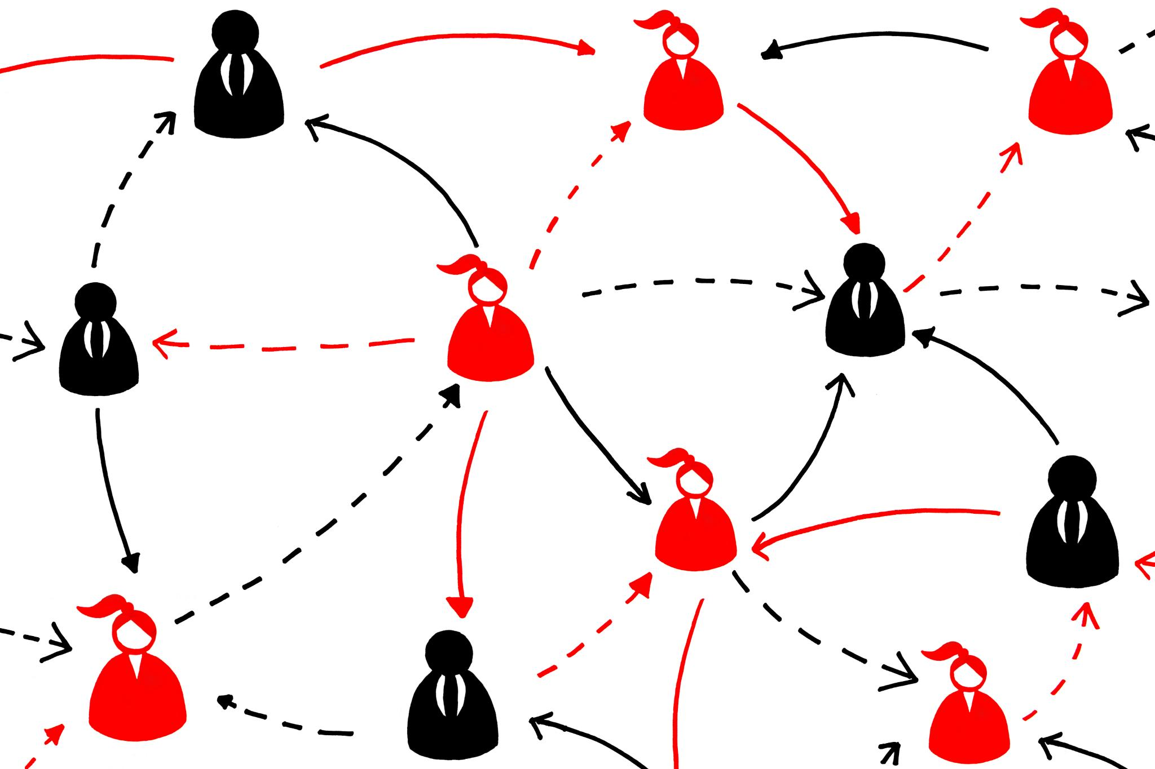
Lack of Communication and Transparency
Consequences of Poor Communication
Lack of information sharing causes mistrust and confusion among individuals and groups.
Value of Transparency
Open and transparent communication builds understanding and encourages active participation in cultural change.

Slide 7

Resource Constraints and Competing Priorities
Impact of Resource Limits
Limited resources restrict the ability to fully support culture initiatives effectively and consistently.
Managing Competing Demands
Multiple organizational demands can shift attention away from culture-building efforts and priorities.
Prioritization for Success
Allocating adequate focus and support through prioritization is essential to advancing culture initiatives.

Slide 8

Sustaining Cultural Change Over Time
Ongoing Effort and Reinforcement
Sustaining culture demands continuous effort and consistent reinforcement across all organizational levels.
Continuous Evaluation
Regular assessment ensures the culture evolves and remains aligned with organizational goals.
Embedding Culture into Practice
Integrating cultural values into daily practices strengthens organizational identity and performance.

Slide 9
Conclusion
Understanding Challenges
Recognizing barriers is essential for building a just and learning organizational culture.
Strong Leadership
Effective leadership drives commitment and fosters a culture of trust and continuous improvement.
Communication and Trust
Open communication helps cultivate trust, supporting organizational learning and growth.
Notes:
.

Slide 10
References
Olmstead, L. (2024, December 23). How to create a learning Culture: 18 best practices. The Whatfix Blog | Drive Digital Adoption. https://whatfix.com/blog/learning-culture/
Steingold, L. (2025, February 19). Building a Learning Culture: A Comprehensive guide. Whale. https://usewhale.io/blog/building-a-learning-culture/
Forum, S. P. (2025, June 30). Creating a just and learning culture. Social Partnership Forum. https://www.socialpartnershipforum.org/articles/creating-just-and-learning-culture
Notes:
.

